Slide 1
Organic Chem Review
If you know this, you’re all set
and you have low kinetic energy
These are “all mixed up” .
You will need your reference table NOW, not later.

Slide 2
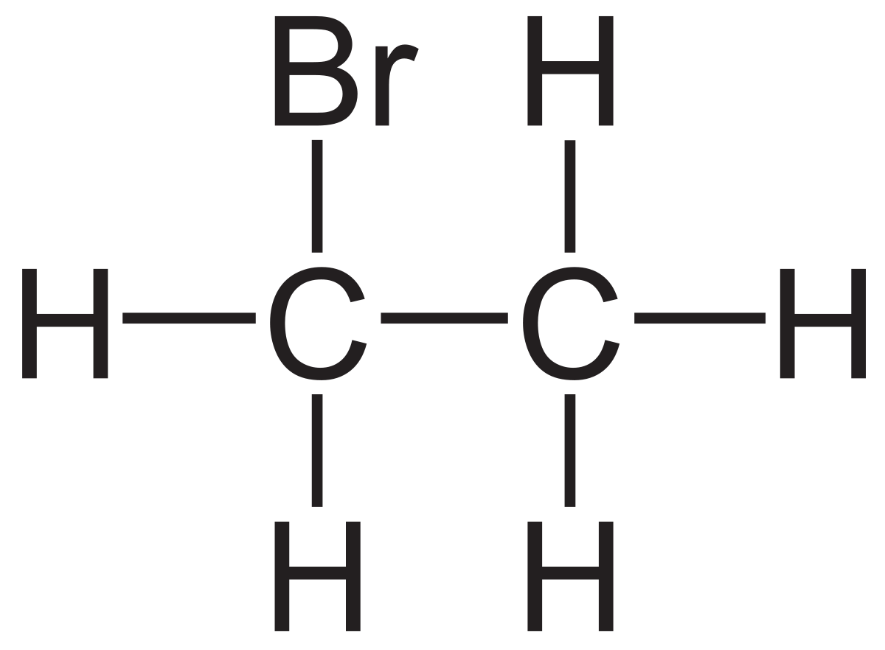
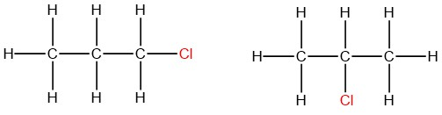
Name these molecules

Slide 3
All are HALOCARBONS
Bromoethane, no numbers needed, the Br is on the “first” carbon.
Then, 1chlorpropane or 2chloropropane,
You HAVE to say to which carbon that the Cl is bonded to.

Slide 4
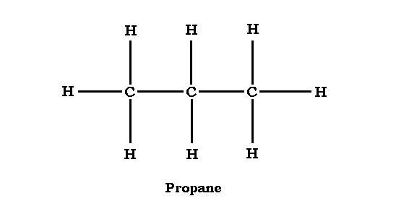
Name these molecules
H
H
N
N
H H

Slide 5
Both are amines
H
H
N
N
H H
1propanamine 2 propanamine

Slide 6
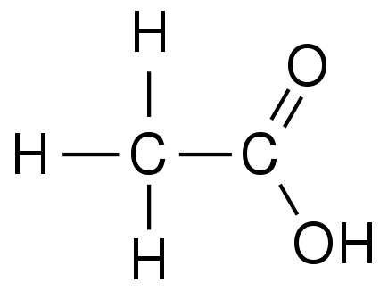
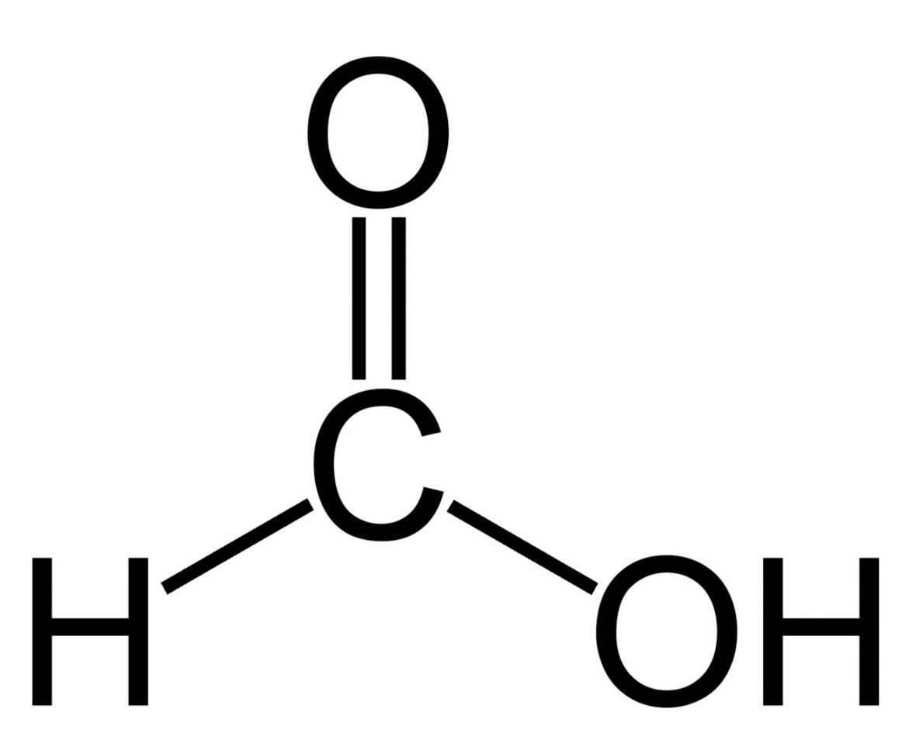
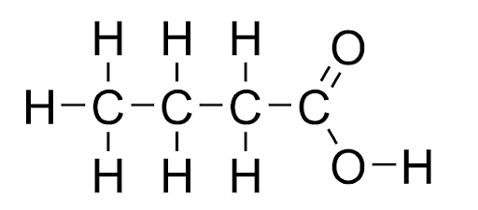
Name these molecules

Slide 7
All are organic acids
Ethanoic acid (2 carbons)
Butanoic acid (4 carbons)
Methanoic acid
(1 carbon)

Slide 8
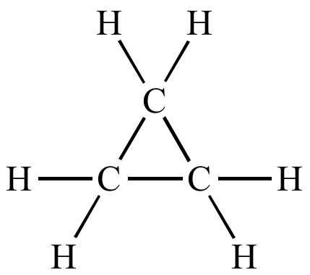
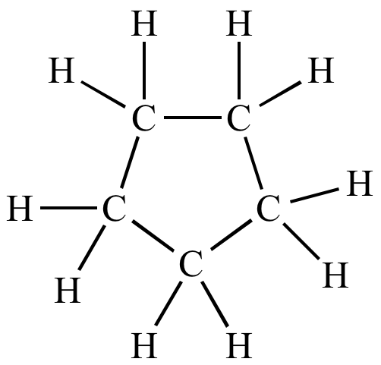
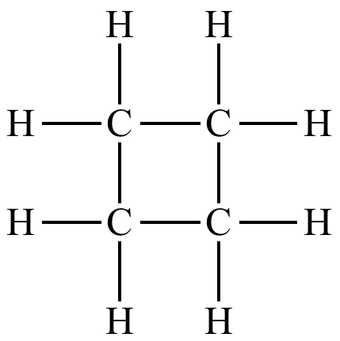
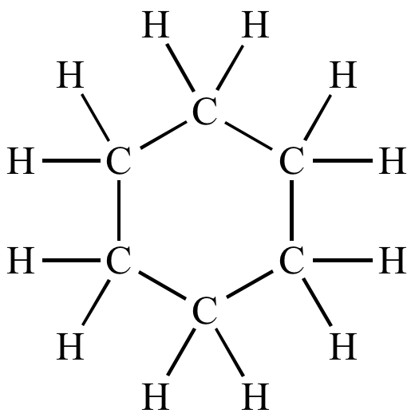
Name these molecules

Slide 9
Cyclo-molecules loop on themselves.
CYCLOPROPANE - 3C
CYCLOBUTANE - 4C
CYCLOPENTANE - 5C
CYCLOHEXANE - 6C
CYCLOPENTANE - 5C

Slide 10
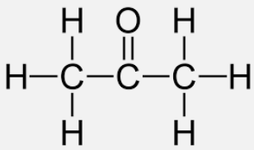
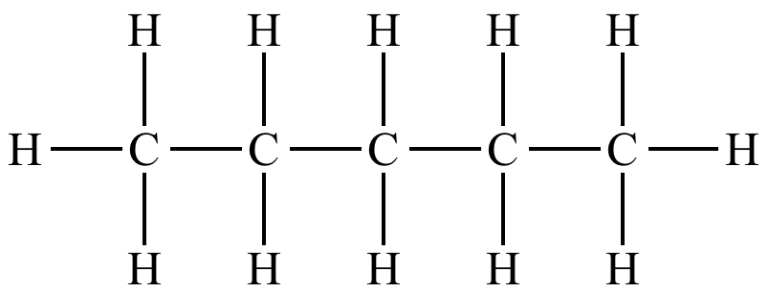
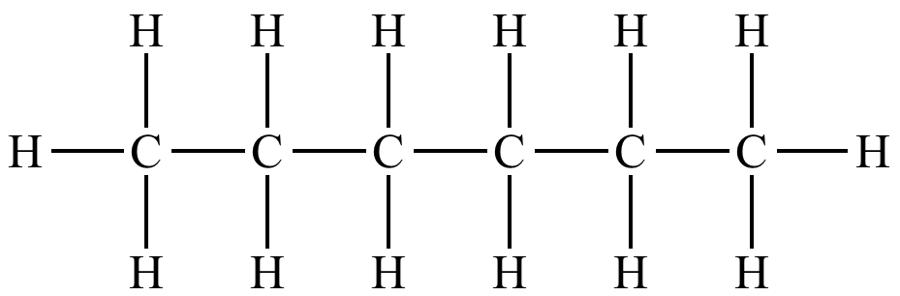
Name these molecules
O
O

Slide 11
Ketones are we!
propanone (no number needed, too small)
O
2pentanone (oxygen is bonded on C#2)
O
3hexanone (oxygen is bonded on C #3)

Slide 12
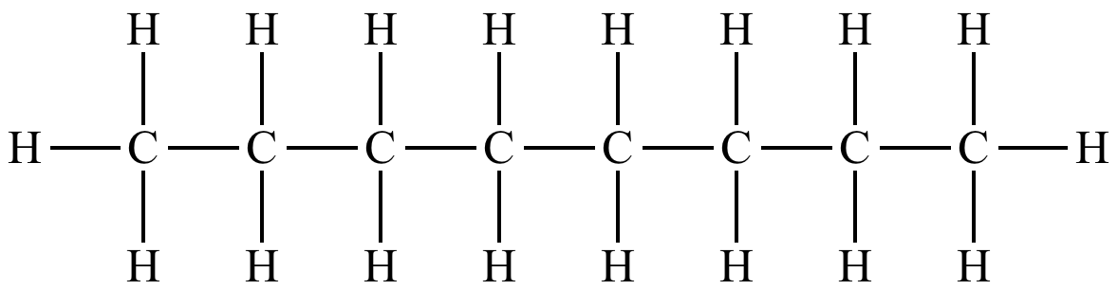
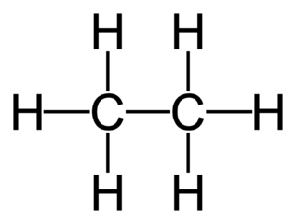
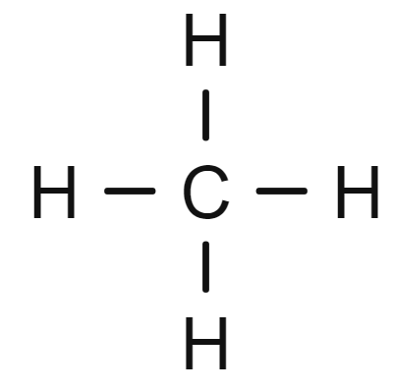
Name these molecules

Slide 13
Alkanes are US.
Saturated hydrocarbons,
only undergo substitution reactions.
pentane
octane
ethane
methane

Slide 14
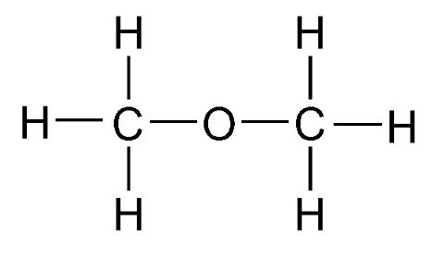
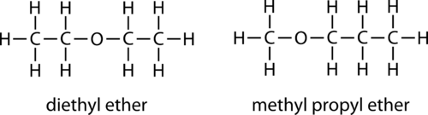
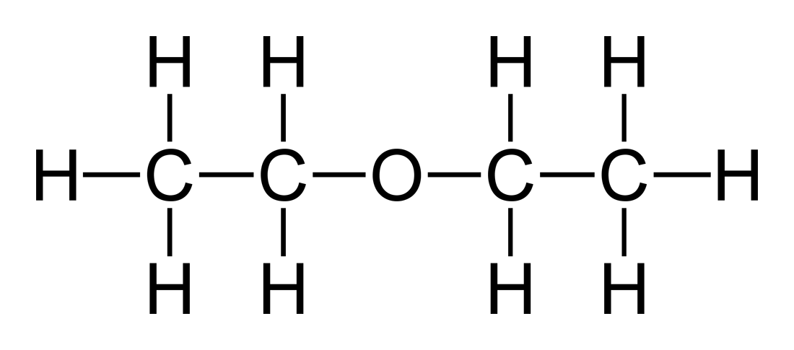
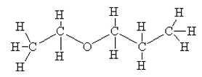
Name these molecules

Slide 15
We are ethers, one and all!
Dimethyl ether
Not methyl methyl XX
Methyl Propyl ether
Diethyl ether
Not ethyl ethyl XX
Ethyl Propyl ether (cool drawing)

Slide 16
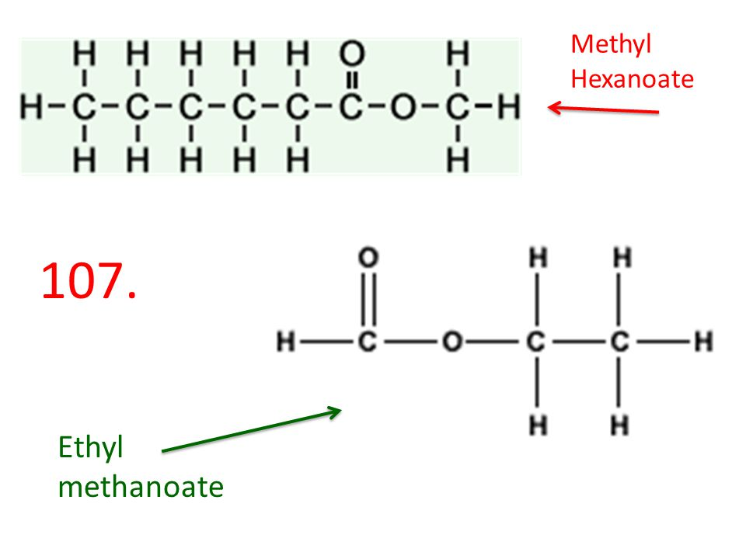
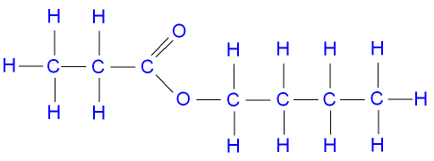
Name these molecules

Slide 17
ESTERS smell good!
Methyl hexanoate
Ethyl methanoate
Butyl propanoate

Slide 18
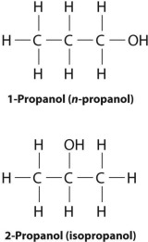
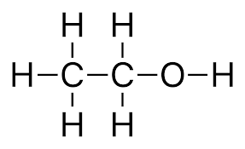
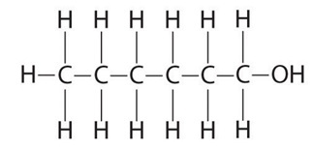
Name these molecules

Slide 19
These are alcohols
ETHANOL
1-PROPANOL
1-HEXANOL
2-PROPANOL

Slide 20
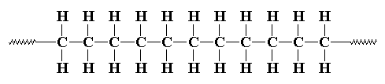
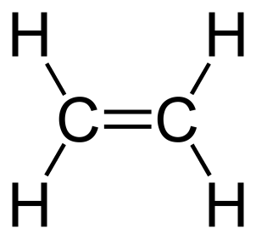
NAME THESE REACTIONS
C₆H₁₂O₆ ^{in yeast with water} 2CH₃CH₂OH_{(AQ)} + 2CO_{2(G)}
catalyst
n

Slide 21
NAME THESE REACTIONS
C₆H₁₂O₆ ^{in yeast with water} 2CH₃CH₂OH_{(AQ)} + 2CO_{2(G)}
This is fermentation, the formation of ethanol alcohol
catalyst
n
This is polymerization, the formation of a polymer or plastic

Slide 22
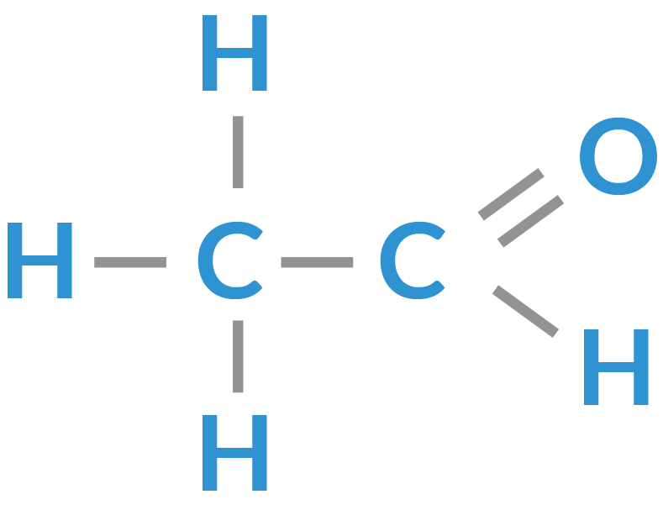
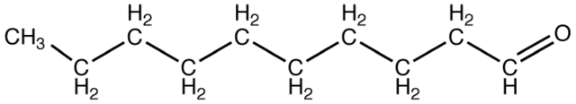
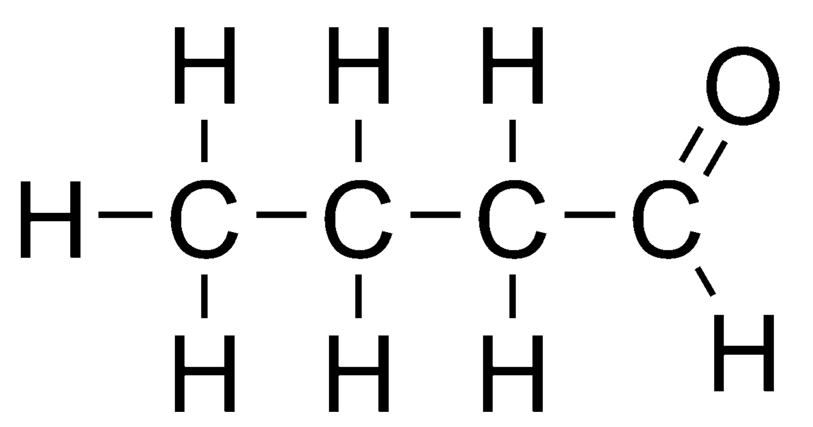
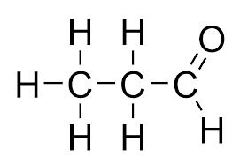
Name these molecules

Slide 23
All ALDEHYDES
ETHANAL
DECANAL
BUTANAL
PROPANAL

Slide 24
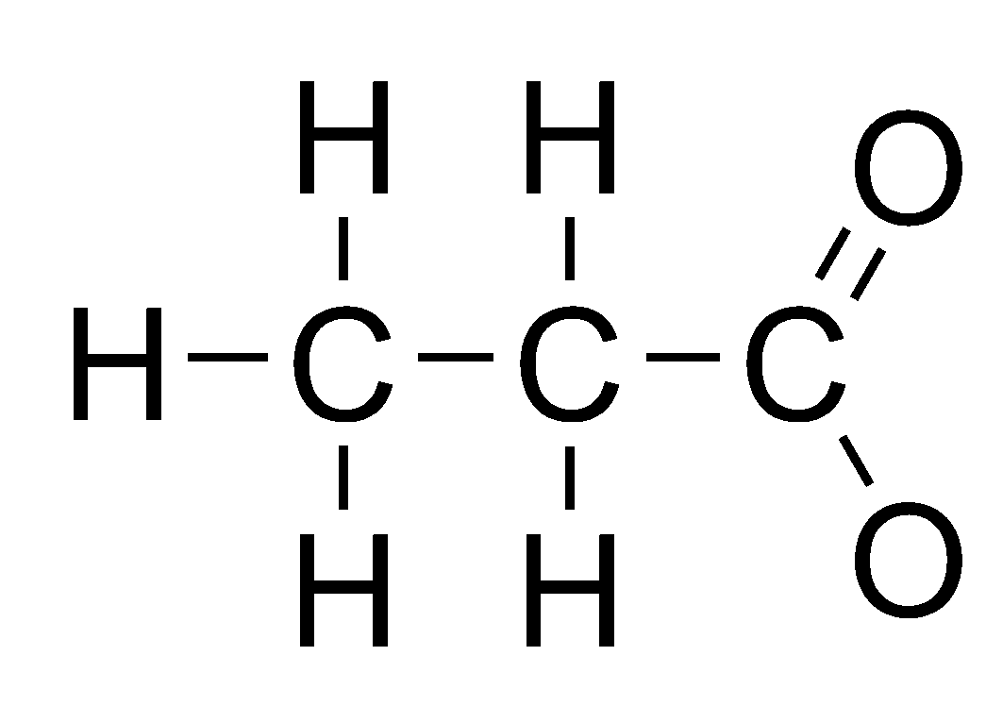
NAME THESE REACTANTS
H H
+
HO
C
C
H
OH
H H
Draw & NAME both products. Type of reaction?

Slide 25
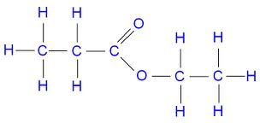
NAME THESE REACTANTS
H H
+
HO
C
C
H
OH
H H
+ HOH_{(L)}
Ethyl propanoate + water. ESTERFICATION

Slide 26
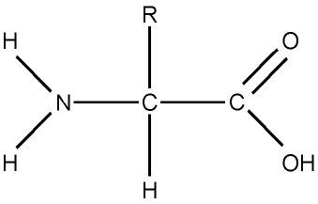
What are the 2 functional groups in this molecule? It’s glycine. What “class” of molecules do you think it fits into?

Slide 27
–NH₂ on the left is an amine group
–COOH on the right is an organic acid
Together it’s an AMINO ACID

Slide 28
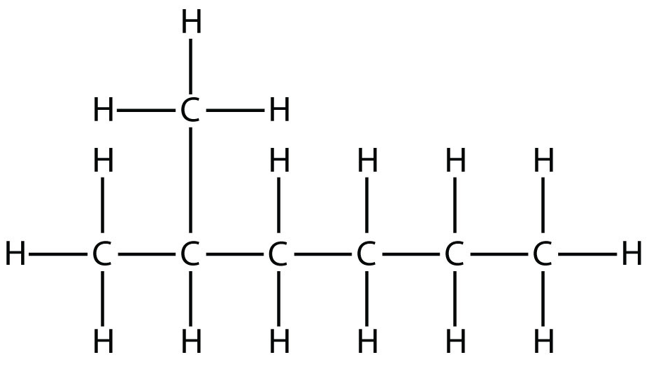
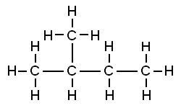
Name these molecules
Name the straight-line alkane isomers for each one too.

Slide 29
Name these molecules
2methylhexane 2methylbutane
isomers: heptane pentane

Slide 30
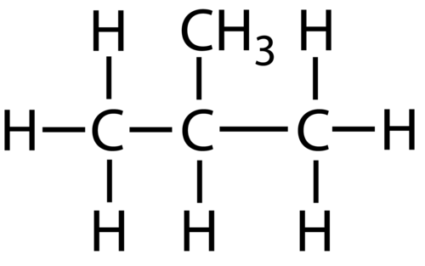
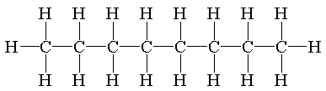
Name these molecules
CH₃
CH₃
CH₂
Cl
Cl

Slide 31
Methyl propane
3ethyl 5,8 dichloro-octane
CH₃
CH₃
CH₂
Cl
Cl

Slide 32
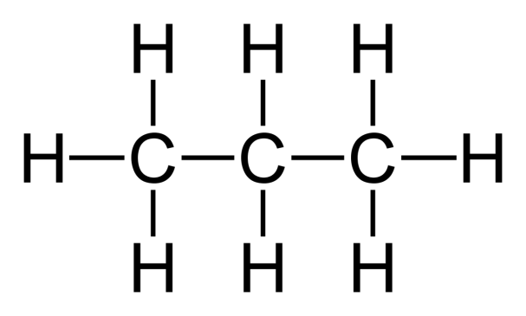
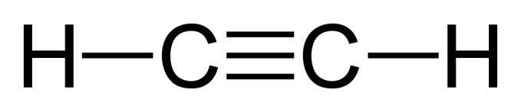
NAME THESE REACTIONS
and all molecules too.
+ F₂
F + HF
F F
+ F₂
H—C=C—H

Slide 33
Propane + fluorine make 1-fluorpropane +
hydrogen monofluoride. SUBSTITUTION a saturated alkane lets
one F atom in at a time.
+ F₂
F + HF
ETHYNE + fluorine make 1,2 difluorethene
ADDITION an UNSATURATED alkyne
lets 2 F atoms in in one step.
F F
+ F₂
H—C=C—H

Slide 34
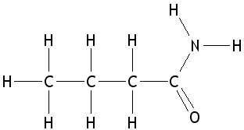
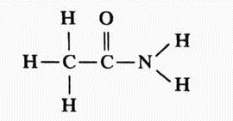
Name these molecules
O
CH₃ – CH₂ – CH₂ – CH₂ – CH₂ – C – NH₂

Slide 35
Name these molecules
Butanamide
Ethanamide
O
Hexanamide
CH₃ – CH₂ – CH₂ – CH₂ – CH₂ – C – NH₂

Slide 36
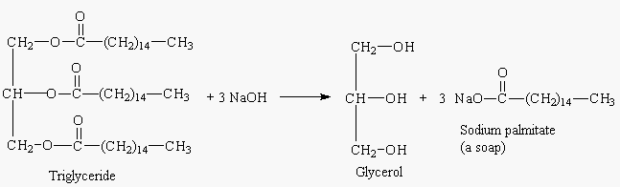
NAME & EXPLAIN THIS REACTION

Slide 37
CV
SAPONIFICATION, chemistry produces SOAP
CV
CV
CV
CV
CV
A FAT or triglyceride, is a huge molecule with 3 individual ESTER groups (circled in red).
Makes a
TRIPLE
ALCOHOL called glycerol
(circled in red)
PLUS
3 giant molecules called a SOAP, with a cation inside!
PLUS
3 BASES

Slide 38
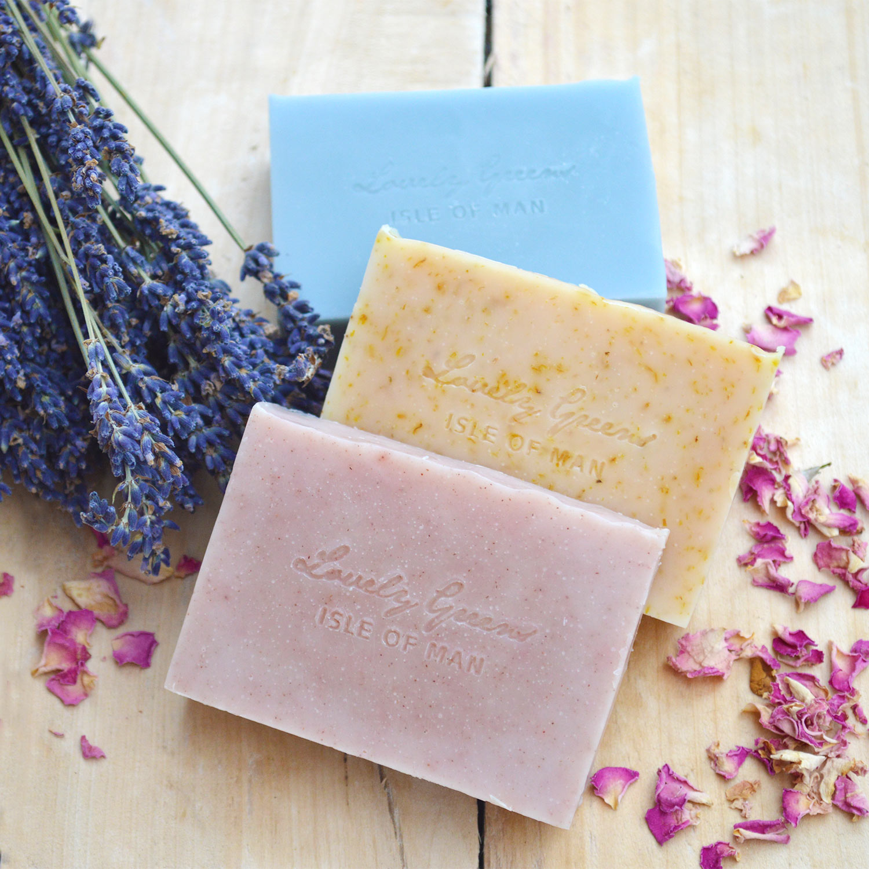
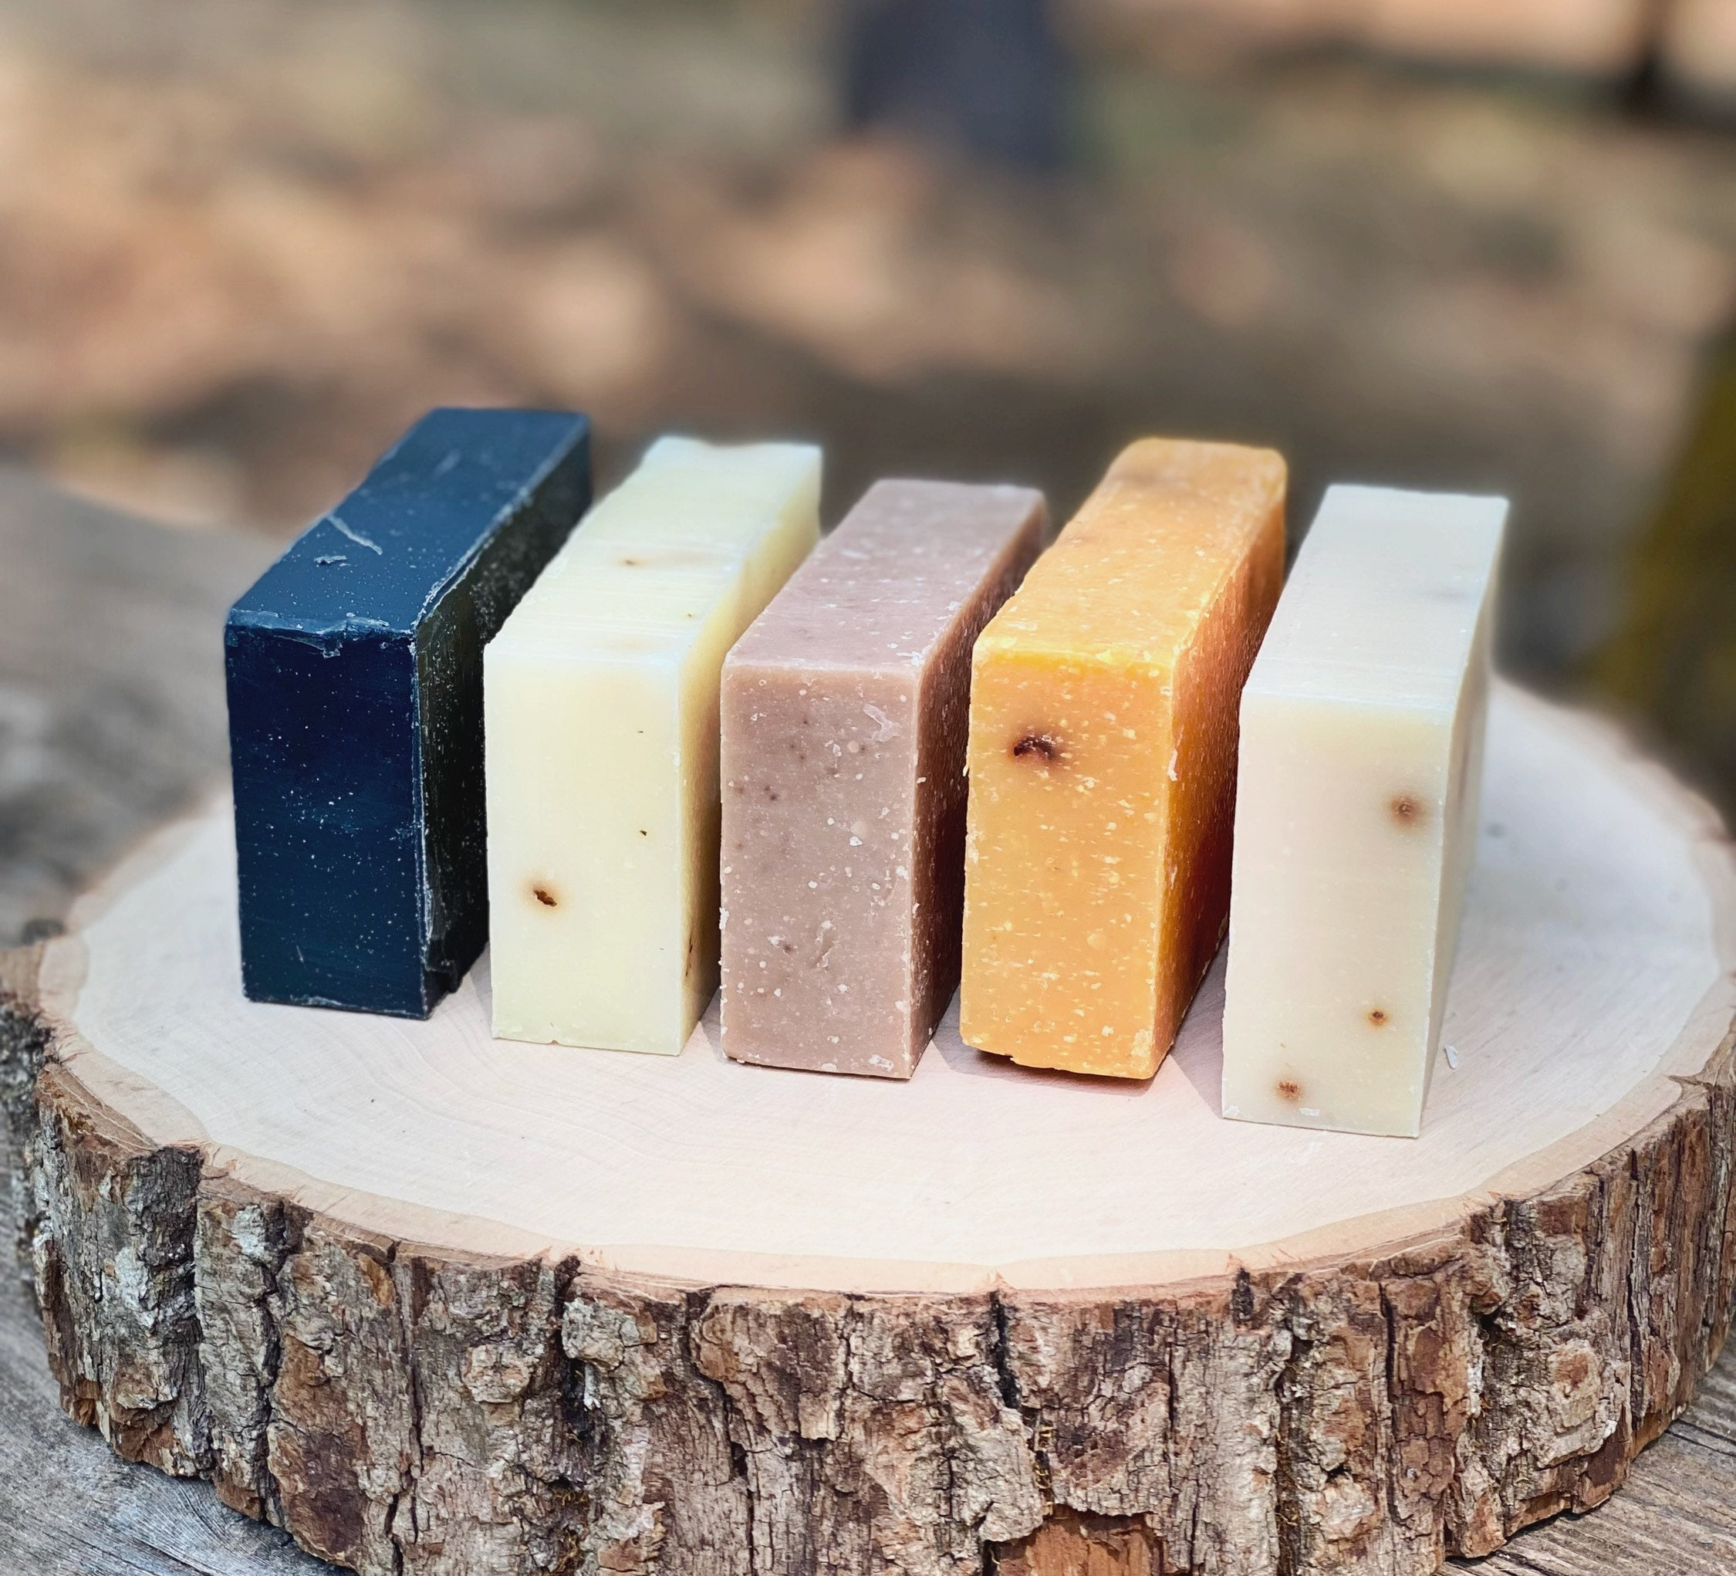
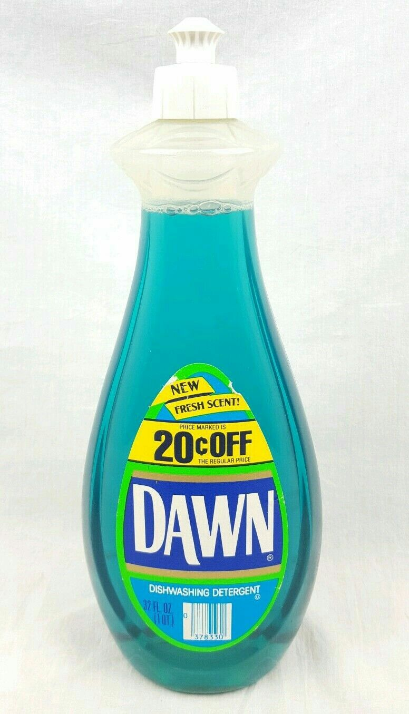
SAPONIFICATION
SOAP
Same first 4 letters.
There are so many kinds of soap made from many different kinds of reactants.
Any fats, animal or vegetable or oil will work.
Any bases or mixtures of bases work too, as long as they’re strong.
Depending upon what you start with, you get one of many kinds of “triple” alcohols, and then 3 SOAP MOLEUCLES which contain ions!
THREE IS OUR “LUCKY NUMBER”. And the molecules are way to big to name!

